Slide 1
How do annual members and casual riders use Cyclistic differently?
Presented by: Prateek Purohit
Last Updated: 9th Nov 2023

Slide 2
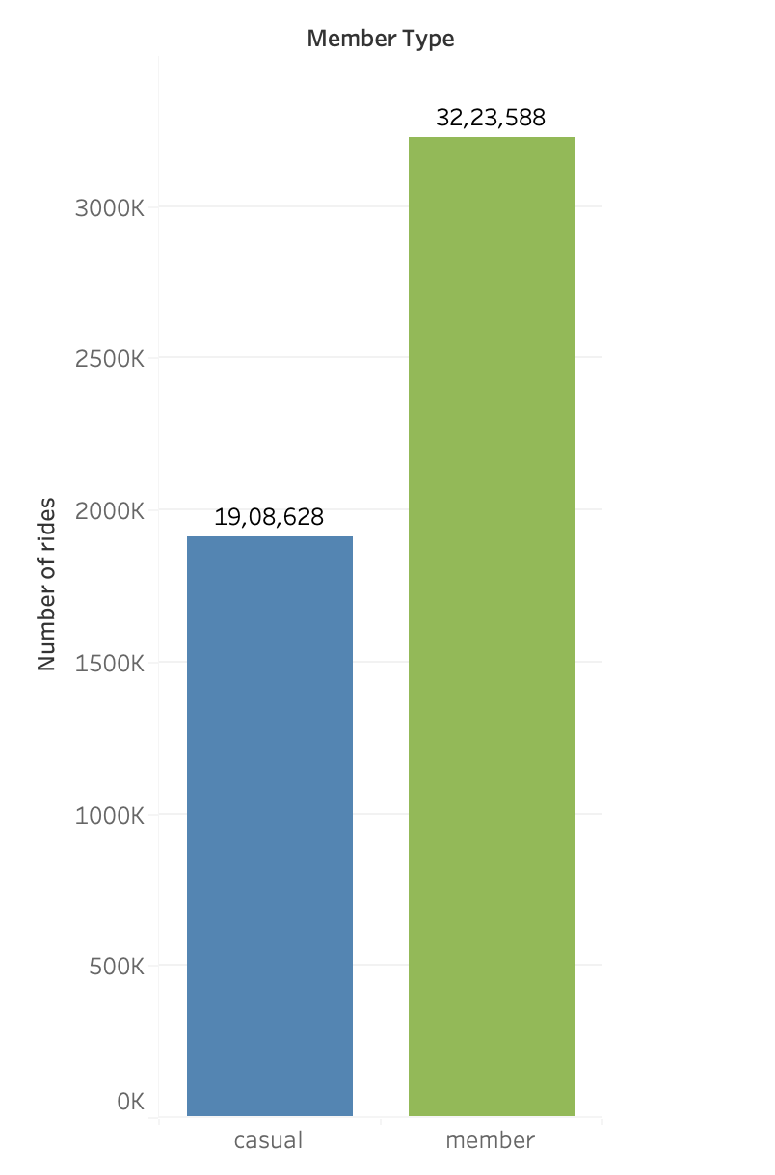
General Information
Primary Objective: To find difference between casual riders and annual members.
Data: 2023 (January to October)

Slide 3
Number of rides each day?

Slide 4
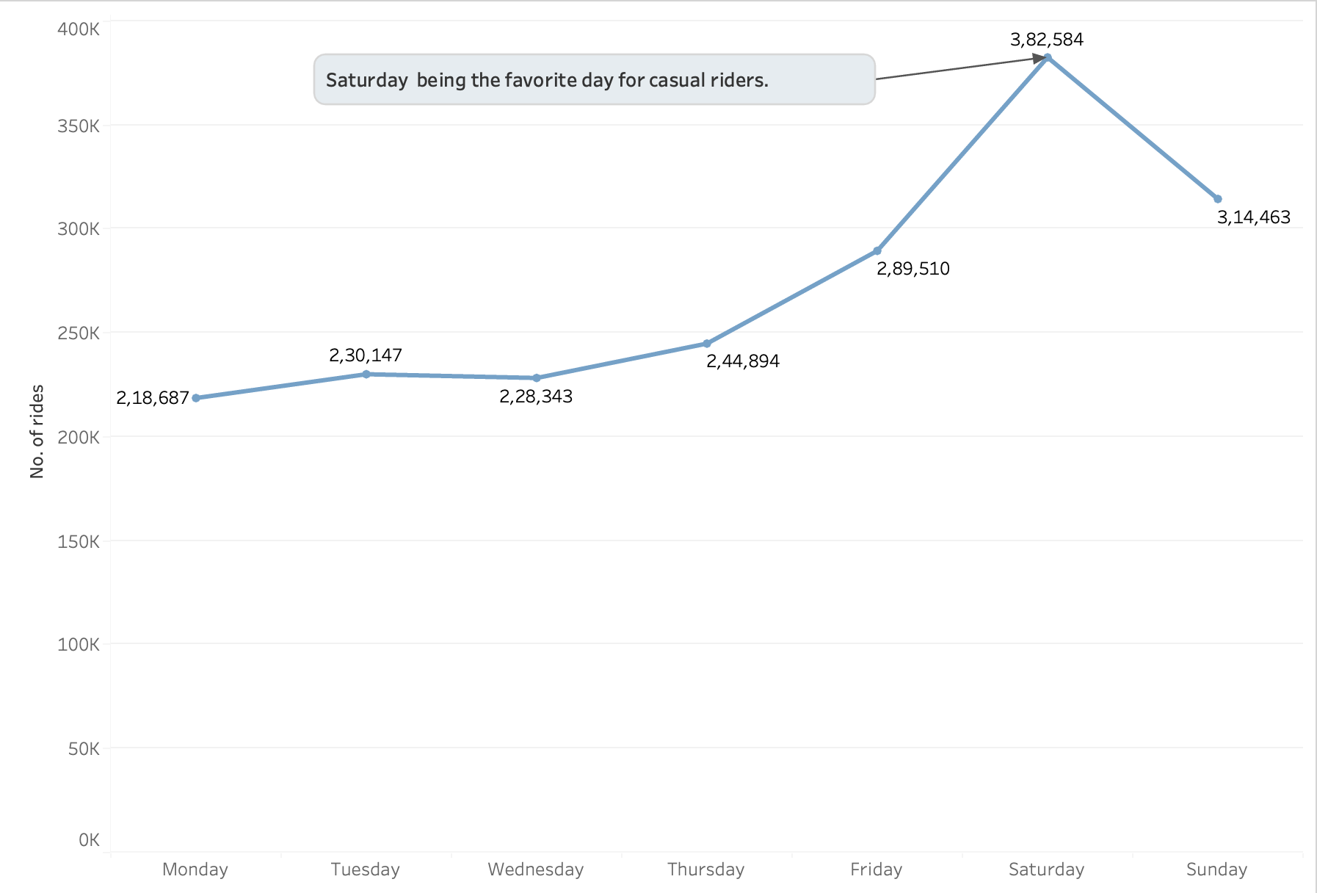
Casual riders enjoy cyclistic more during the weekends.
Saturday shows the highest number of casual rides.
Number of rides each day (casual riders)

Slide 5
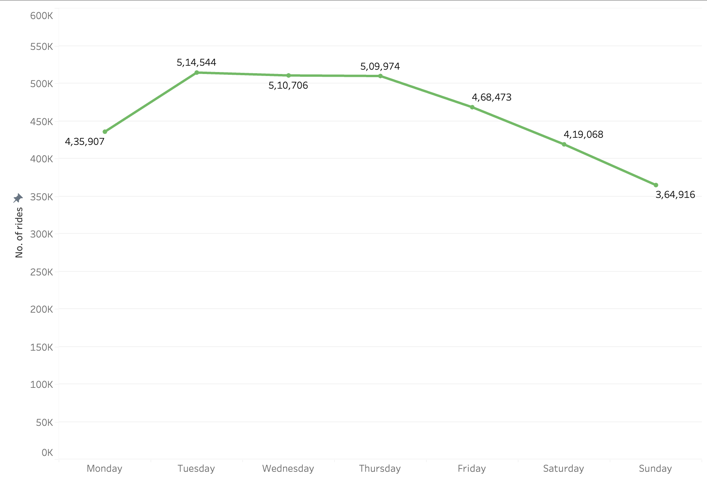
Annual members tend to use cyclistic more during the business days.
Tuesday has the highest number of rides taken.
Number of rides each day (annual members)

Slide 6

Average ride length ?

Slide 7
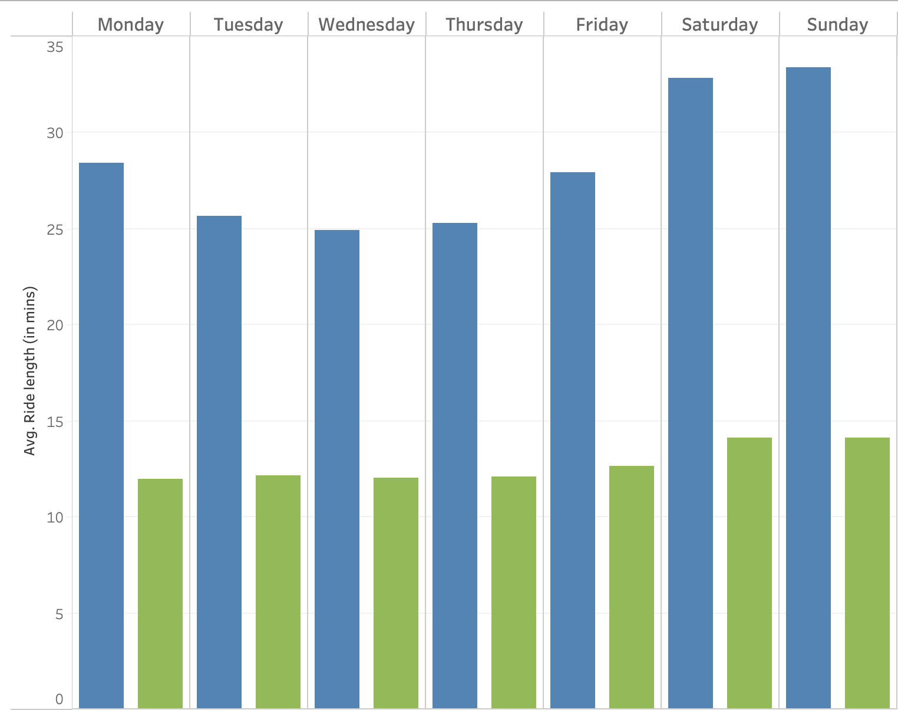
Weekend shows the highest average ride length for casual riders.
For Annual members avg ride length is pretty consistent throughout the week.
Avg. Ride length:
Casual > 2 * Annual
Ride length: The amount of time the bike was used in a single use.

Slide 8
Favourite season?

Slide 9
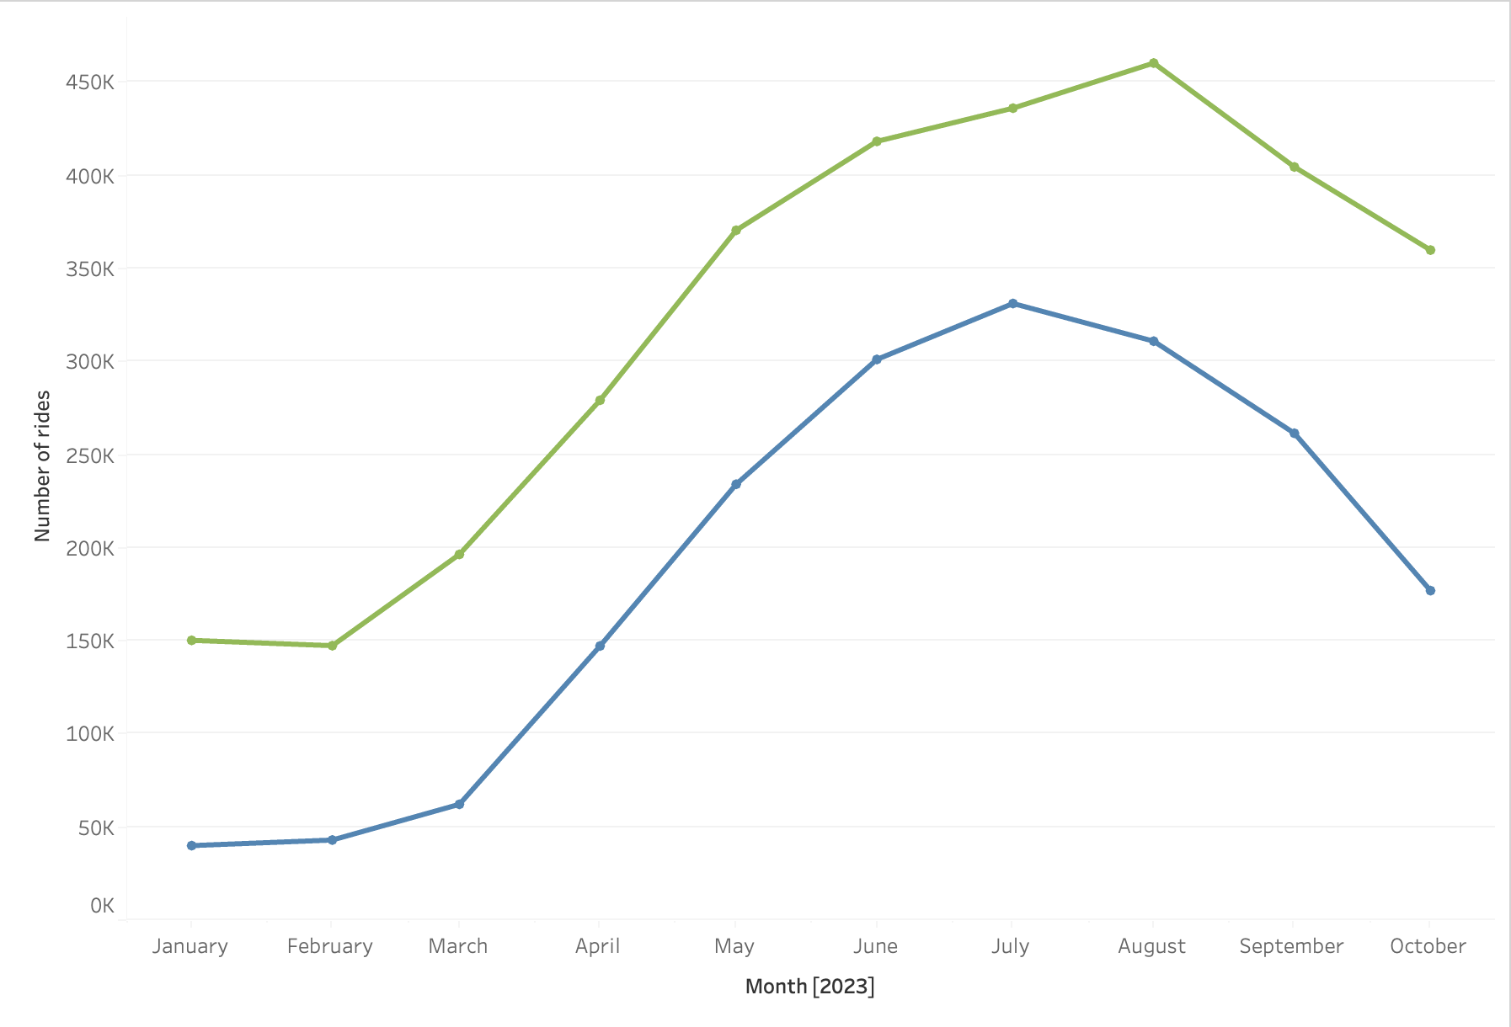
Spring and Summer seems to be the post popular seasons for both
Annual Members and Casual riders.
July is the favorite month for casual riders.
Number of rides per month

Slide 10
Conclusion
# 1
# 2
# 3
Casual riders use cyclistic more during the weekend whereas annual members use it mostly during business days.
Casual riders use Cyclistic at least twice as long as compared to annual members.
Spring and Summer are both favorite seasons for casual and annual members.

Slide 11
What would I suggest?

Slide 12
Suggestions
Creating memberships that provide benefits suitable for weekends and for long riders (traits shown by casual riders)
# 1
Creating awareness and market strategy to promote cyclistic during seasons other than spring and summer.
# 2
# 3
Spring and Summer are both favorite seasons for casual and annl members.

